Slide 1
EUGLOH Intercultural Skills Programme 2024
– Call for Mentors
(fully funded training opportunity in Lund
16-18 October 2024)

Slide 2
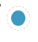
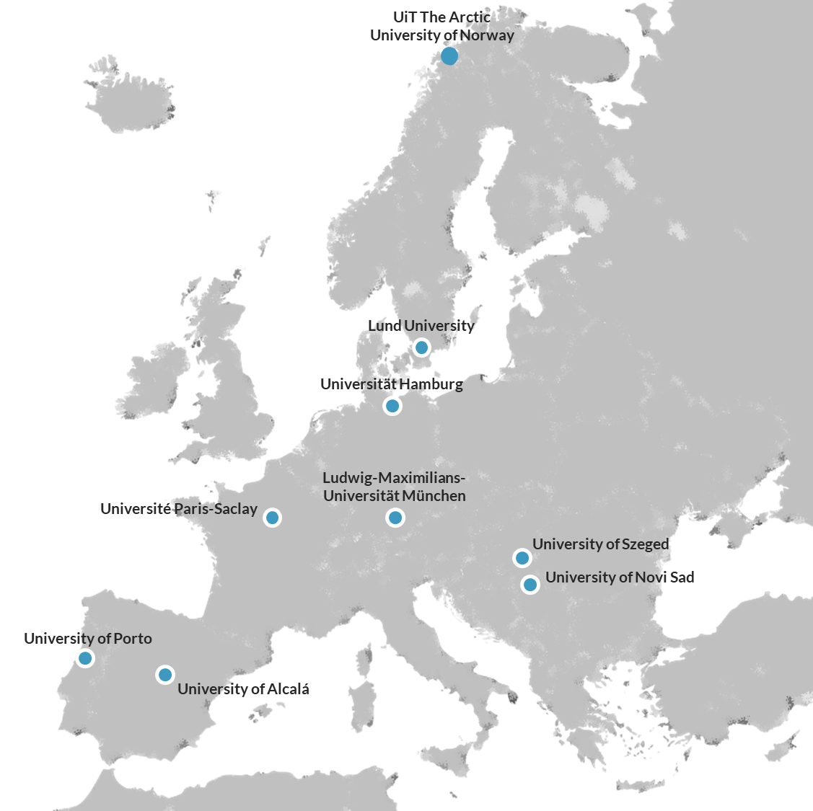
What is EUGLOH?
9 Universities, 1 Goal: Building Europe’s Campus for Global Health
Global Health: A comprehensive topic embracing multidisciplinarity and responding to crucial societal challenges
  The European University Alliance for Global Health includes partner universities:
  from all geographical corners of Europe
  with a comprehensive educational offering made exceptional by strong medical faculties
  complemented by world-renowned large-scale research infrastructures
  surrounded by rich innovation eco-systems

Slide 3
You as a mentor
are a student at one of the EUGLOH universities, at any study level or academic background and who preferably has knowledge about EUGLOH
are responsible for guiding and helping your mentor group (6-8 mentees per group) at your home university
will be facilitating discussions in your mentor group during the group meet ups
will help to organise social events

Slide 4
Programme Layout for mentors
3 day training session
Training session for mentors, in person at Lund university
16-18 of October 2024 (fully funded by EUGLOH)
4 hours planning activites with staff
Back at your home institution you will be supported by university staff when planning your MENTOR GROUP ACTIVITY and the ALL GROUP ACTIVITY
Mentor group activity 1
You meet with your mentor group (your mentees). Staff is not involved. Social activity but with purpose
All groups activity 1
Another get-together with your mentor group for a social activity, i.e pot luck. Admin staff involved. Purely social.
Mentor group activity 2
You meet a second time with your mentor group.
All groups activity 2
Second social activity for all groups.
for the exact dates of the MENTOR GROUP ACTIVITIES
and the ALL GROUP ACTIVITIES see slide 6
Evaluation session
Notes:
Programme outline
Mid-October
We could give the groups – tasks / discussion questions based on lecture 1

Slide 5
Training for mentors in Lund
16-18 of October 2024
Wednesday | Thursday | Friday
arrival in the morning | 09.00-10.30 session 1 | 09.00-10.30 session 4
 | 10.30-11.00 coffee break | 10.30-11.00 coffee break
13.00 registration and welcome | 11.00-12.00 session 2 | 11.00-12.00 session 5
13.30-14.30 introduction to the programme | 12.00-13.00 lunch | 12.00-13.00 lunch
14.30-15.00 coffee break | 13.00-15.00 session 3 | 13.00-15.00 social activity
15.00-17.00 keynote speaker | 15.00-16.00 campus tour | 15.00-16.00 wrap-up and goodbye
 | 19.00-22.00 dinner

Slide 6
What happens after the mentor days in Lund?
When | What
Online Lecture 1 24th of October, 16.00-17.30 | Garo Harwood from Lund University will give the first lecture providing an introduction to the topic, covering things such as “what is meant by ‘culture’, subjective/objective culture, the iceberg model, cultural values, individualist/collectivist (or dependent/interdependent); cognition, proxemics, and perception”.
First meet-up in mentor groups Some time between the 25th of October and 4th of November. | Each mentor group meets by themselves. The mentor in each group helps set up the meeting and facilitates the meeting. The aim of this meeting is for the students (both mentor and mentees) to get to know each other in their groups and to reflect on the first lecture. There will also be some discussion questions to prepare for the next lecture.
First all groups meet-up Sometime between the 4th and 12th of November | If there is more than one mentor group at your university, all of these groups meet and carry out a fun activity together to share different cultures. For example, pot luck, games from different countries, movie night etc.
Online Lecture 2 13th of November, 17.30-19.00 | Csilla Ducrocq from Université Paris-Saclay will give the second lecture and will cover things like: high and low context communication, communication, time, hierarchy. She will include questions to discuss BEFORE this lecture. During this lecture you will discuss concrete examples and critical incidents.
Second meet-up in mentor groups Sometime between the 14th and the 20th of November | Each mentor group meet by themselves. The mentor in each group helps set up the meeting and facilitates the meeting. The aim of this meeting is to reflect on the last lecture, as well as the social interaction.
Second all groups meet-up Sometime between the 21th and the 26th of November | If there is more than one mentor group at your university, all of these groups meet and carry out a fun activity together to share different cultures. For example, pot luck, games from different countries, movie night etc.
Online Lecture 3 27th of November. 17.00-18.30 | Raquel Lazaro from University of Alcalá will give the third and final lecture. She will cover being aware of own culture and our own bias, visit the concepts of unconscious bias. There will be a preliminary exercise and test on unconscious bias to discuss it in groups.
Notes:
Programme outline
Mid-October
We could give the groups – tasks / discussion questions based on lecture 1

Slide 7
How you benefit from partaking as a mentor
You will meet people from the EUGLOH partner universities.
It is a great opportunity to gain awareness of your current intercultural competence level. Wherever you find yourself at right now, you will able to improve and sharpen your intercultural (communication) skills.
Additionally you will be trained in your discussion and moderation skills, how to manage groups during your days in Lund.
All of the above will future proof your career as intercultural competences, moderation and discussion skills are vital

Slide 8
What are next steps?
If you are interested and/or have questions, or want to apply please reach out to
kim.barnstorf@ikk.lmu.de and/or an eugloh@lmu.de
Should you want to apply please send a motivational letter to kim.barnstorf@ikk.lmu.de and/or an eugloh@lmu.de covering questions such as
  Why do you want to be a mentor in the EUGLOH Intercultural Skills Programme?
  Tell us about your current intercultural skills! It can be your cultural background, experience abroad or other intercultural experiences.
  What are you hoping to get out of the EUGLOH Intercultural Skills Programme?
  In what way do you think intercultural skills and you taking part as a mentor will benefit you in your future career?
If your application is successful you will be contacted. The next step is then to attend a digital meeting in the beginning of October with the purpose of introducing the mentors to the programme before travelling to Lund.

